Slide 1
Solving the AI Context Crisis: A RAG-Based Context Provisioning MCP Server
演講者：Frank
國立台北科技大學 資訊工程系
指導教授：鄭有進、謝金雲

Slide 2
Outline
Background
  Model Context Protocol(MCP)
  Retrieval-Augmented Generation(RAG)
Context Provisioning MCP Server
Conclusion
Reference

Slide 3
Background-MCP
MCP (Model Context Protocol) is an open-source standard that connects AI applications to external systems.
Through MCP, AI like Claude or ChatGPT can connect to:
Data sources (local files, databases)
Tools (search engines, calculators)
Workflows (specific prompts)
This enables AI to access key information and perform tasks.
Simple analogy: MCP is like a USB-C port for AI—providing a standardized way for AI to plug into various external systems.

Slide 4
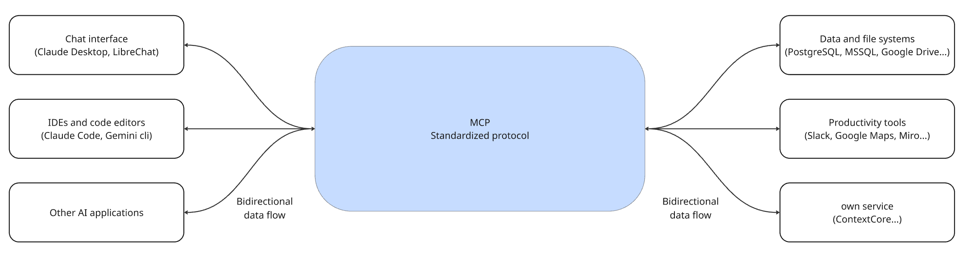
Background-MCP

Slide 5
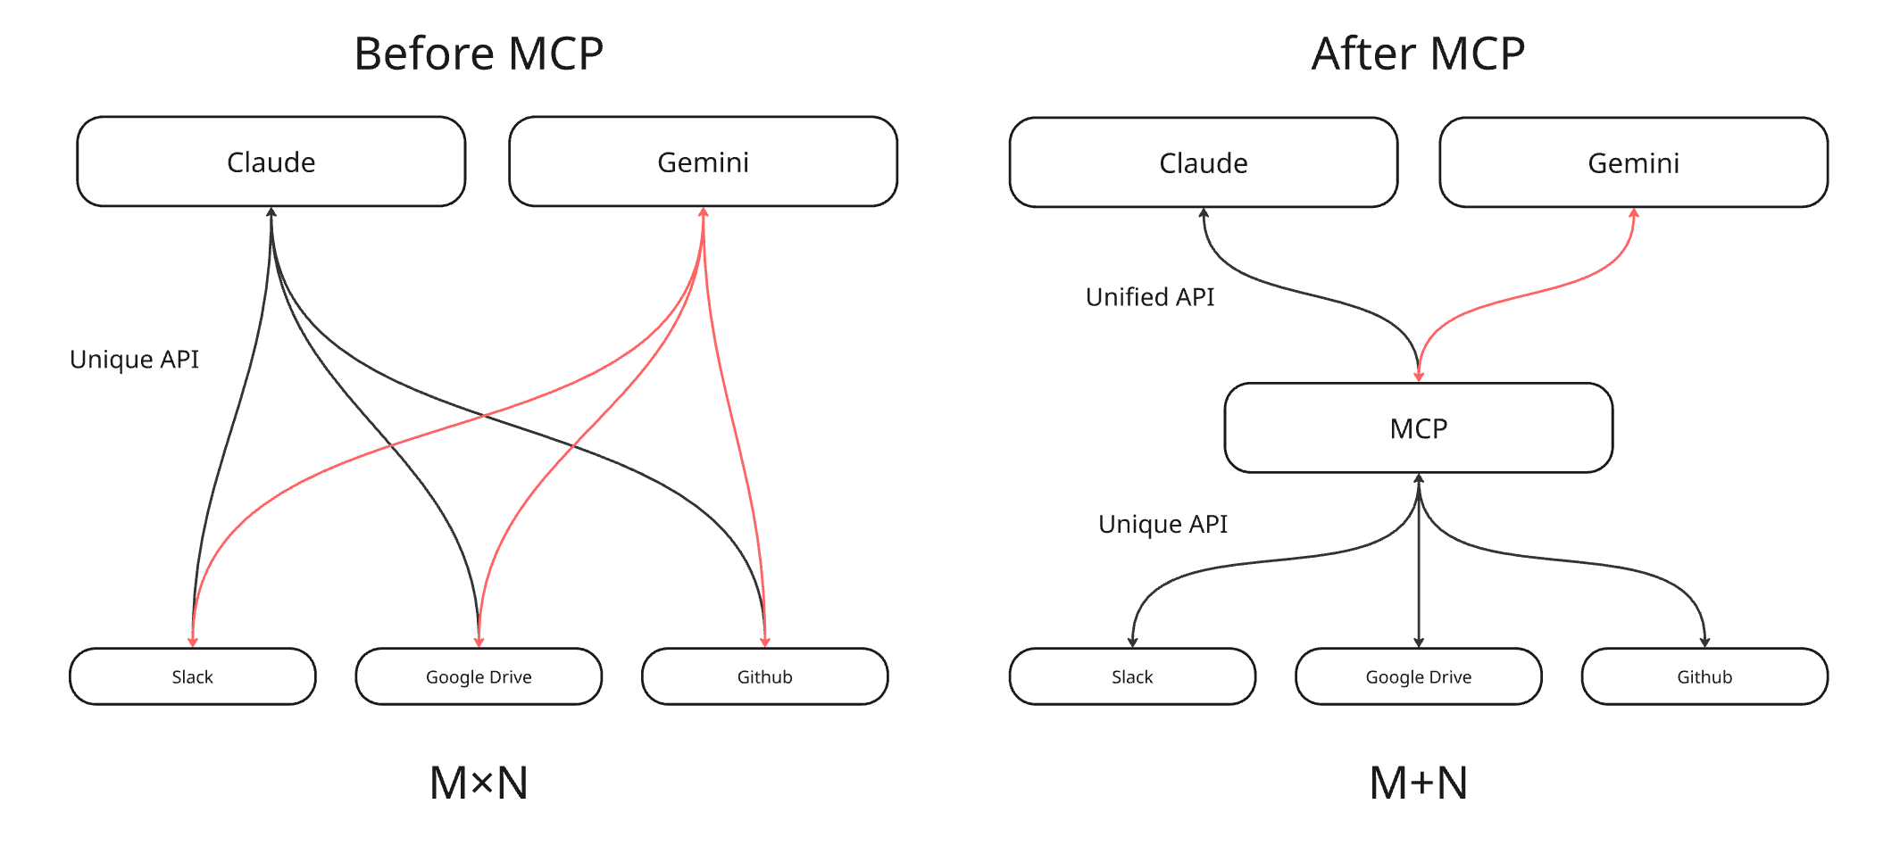
Background-MCP
Notes:
統一介面有甚麼好處?
Before MCP（左圖）
在 MCP 出現之前，每個 LLM 應用都需要為每個外部服務開發專屬的 API 整合。
舉例來說，如果你的 LLM 需要連接 Slack、Google Drive 和 GitHub，就必須分別實作三套不同的連接代碼。每個連接都有自己的認證方式、資料格式和呼叫方法。
這造成了**「M × N 問題」**：M 個 AI 應用乘以 N 個服務，等於需要開發和維護 M × N 個整合。工作量龐大且重複。
After MCP（右圖）
有了 MCP 之後，我們在 LLM 和外部服務之間加入了一個標準化的中間層。
LLM 現在只需要透過統一的 MCP API 與所有服務溝通。無論是 Slack、Google Drive 還是 GitHub，呼叫方式都是一樣的。
雖然底層仍需要各自的 Unique API 來連接實際服務，但這些 MCP Server 只需要開發一次，就能被所有 AI 應用重複使用。
這將問題從 M × N 簡化為 M + N，大幅減少開發和維護成本。
MCP aims to simplify this by providing a common API and transforming this into an "M+N problem". Tool creators build N MCP servers (one for each system), while application developers build M MCP clients (one for each AI application). MCP defines a client-server architecture where:
Hosts: Applications the user interacts with (e.g., Claude Desktop, an IDE like Cursor, a custom agent).
Clients: Live within the Host application and manage the connection to one specific MCP server. Maintain a 1:1 to connection.
Servers: External programs that expose Tools, Resources and Prompts via standard API to the AI model via the client.

Slide 6
Background-RAG
Retrieval-Augmented Generation (RAG) is a technology that combines information retrieval (Retrieval) and generative AI (Generation). Its primary goal is to address the issue of Large Language Models (LLMs) potentially producing inaccurate, outdated information, or "hallucinations," by retrieving relevant factual information from external knowledge sources to enhance the accuracy and reliability of the responses.
Notes:
Retrieval-Augmented Generation (RAG)，中文稱為「檢索增強生成」，是一種結合了資訊檢索（Retrieval）和生成式 AI（Generation）的技術。它的主要目的是解決大型語言模型 (LLM) 可能會產生不準確、過時資訊或「幻覺」（hallucination）的問題，透過從外部知識來源檢索相關事實資訊來強化回答的準確性和可靠性。
簡單來說，RAG 就像是給予 AI 快速查找「小抄」的能力，讓它在回答問題時更有依據、更可靠。

Slide 7
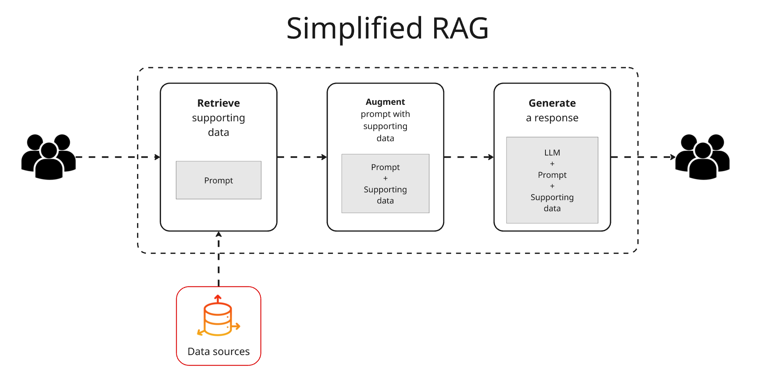
Background-RAG
Notes:
這邊談到概念因為這個不是我想介紹的重點
檢索階段 (Retrieval Phase)：系統會分析使用者的查詢，並從預先建立好的外部知識庫（例如：企業文件、資料庫、網頁內容等）中，搜尋並找出最相關的資訊片段。這個知識庫通常會經過向量化和索引處理，以便進行快速的語意檢索。
增強階段 (Augmentation Phase)：檢索到的相關資訊會被作為「額外的上下文」或「參考資料」，連同原始查詢一起提供給大型語言模型。
生成階段 (Generation Phase)：大型語言模型根據這些豐富的上下文來生成最終答案，而不僅僅依賴其內建的訓練數據。

Slide 8
Context Provisioning MCP Server
Context
I am using ai coding with Claude code. And I hope all of my projects share a common set of development principles (e.g.,DDD, CA, Event Sourcing, CQRS) as a context while Claude code design a complex system.

Slide 9
Context Provisioning MCP Server
Problem
How do we build a scalable, efficient, and reusable Context Provisioning System for an AI (Gemini CLI), enabling it to acquire the precise, relevant knowledge needed for a task without exceeding its Token Limit?

Slide 10
Context Provisioning MCP Server
Forces
  1. Shareability vs. Duplication
  Every project needs the same principles, but copying files creates wasteful duplicates across N repositories.
  2. Maintainability vs. Consistency
  When principles evolve, you must update N copies manually, causing version drift and inconsistency.
  3. Context Completeness vs. Token Limits
  AI needs comprehensive principles to generate correct code, but loading all documentation may exceed token limits.
  4. Relevance vs. Noise
  Most stored principles are irrelevant for specific tasks, and loading everything reduces AI effectiveness.

Slide 11
Context Provisioning MCP Server
Solution
Create a RAG (Retrieval-Augmented Generation) MCP Server that centralizes all common development principles and provides semantic search capabilities for on-demand, selective context retrieval.

Slide 12
Context Provisioning MCP Server
Resulting Context (Consequence)
  - The repetition problem is eliminated. Common principles are now centralized, shareable, and easy to maintain.
  The ”Spec”(common principles) and "Production Code" are now successfully decoupled.
  Retrieval precision determines code quality
Notes:
解耦後好處，單一職責、對於Spec的擴展完全不會影響到production code。

Slide 13
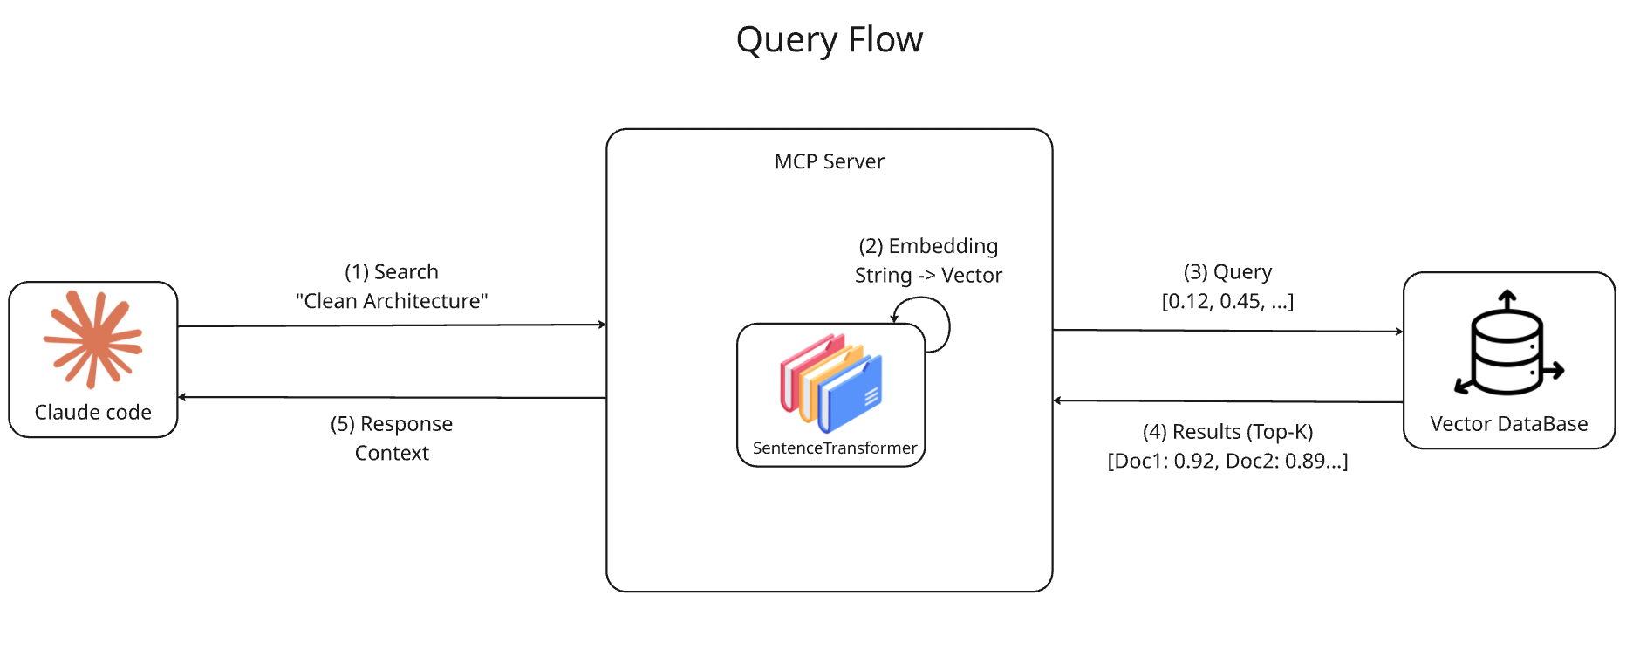
Context Provisioning MCP Server

Slide 14
Conclusion
How to Verify Context Provisioning Mcp Server is Better Than Traditional Methods?
Architecture Compliance
  Under the same prompt, compare the generated ezKanban architecture quality.
Token Efficiency
  When implementing the same use case, observe token consumption differences.

Slide 15
Reference
搞笑談軟工 什麼是Pattern（5）：加入Force
Model Context Protocol (MCP) an overview
Introducing the Model Context Protocol
https://github.com/modelcontextprotocol/servers
Azure Databricks 上的 RAG (檢索增強生成)

Slide 16

Thanks for listening
https://github.com/chun-wei0413/mcp-registry

